Slide 1




Cause of Death
Statistics in Africa
A review of mortality data availability, quality and usability across the WHO African Region
Debbie Bradshaw and Hillary Kipruto
ICD-11 IMPLEMENTATION COMMUNITY OF PRACTICE
Webinar: 21st August 2026
Notes:
Title slide — Cause of Death Statistics in Africa, WHO Mortality Database.

Slide 2
OVERVIEW
What this presentation covers
1
Background
2
WHO Mortality Database
3
Criteria for inclusion
Why cause-of-death data matters and global reporting obligations
Which African countries are included
How submitted data is assessed for inclusion
4
Review of regional data
5
SCORE assessment
6
Way forward
Availability, quality and usability of data submitted
Death registration and cause-of-death certification systems
Opportunities to strengthen mortality data in the region
02 / 20

Slide 3
BACKGROUND
Cause-of-death data underpins the SDGs
No SDG indicator for cause-of-death reporting
Why cause-of-death data matters
The SDGs contain explicit indicators for birth registration (16.9.1) and completeness of birth and death registration (17.19.2b).
There is no dedicated SDG indicator for cause-of-death reporting.
~24 SDG indicators
are underpinned by cause-of-death data — particularly mortality from maternal causes, non-communicable diseases, injuries, suicide, infectious diseases and environmental risks.
03 / 20

Slide 4
BACKGROUND
Countries have been obliged to report cause-of-death data to WHO since 1948
1948
Nearly eight decades on, reporting from the African Region remains far from complete.
04 / 20

Slide 5
BACKGROUND
Quality of cause-of-death data reported to WHO
Number of Member States providing data, by WHO region, 2013–2023
WHO region | Very-low quality / no data | Low quality | Medium quality | High quality | Total
African Region | 43 | 1 | 2 | 1 | 47
Region of the Americas | 3 | 7 | 6 | 19 | 35
South-East Asia Region | 7 | 1 | 2 | 0 | 10
European Region | 2 | 4 | 12 | 35 | 53
Eastern Mediterranean Region | 8 | 10 | 1 | 2 | 21
Western Pacific Region | 13 | 6 | 2 | 7 | 28
Global | 76 (39%) | 29 (15%) | 25 (13%) | 64 (33%) | 194 (100%)
The African Region has by far the weakest data: 43 of 47 Member States provide very-low-quality or no data.
Source: World Health Statistics, 2026
05 / 20

Slide 6
WHO MORTALITY DATABASE
Only four countries reporting for 2012-2023 are included
Quality criteria
Data quality
4 / 47
1
High quality
ICD coded data
Seychelles
Completeness of registration
Medium quality
countries in the AFRO Region have data included in the WHO Mortality Database
Mauritius, South Africa
2
Proportion ill-defined causes
Poor quality
Botswana
3
Source: World Health Statistics, 2026
06 / 20

Slide 7
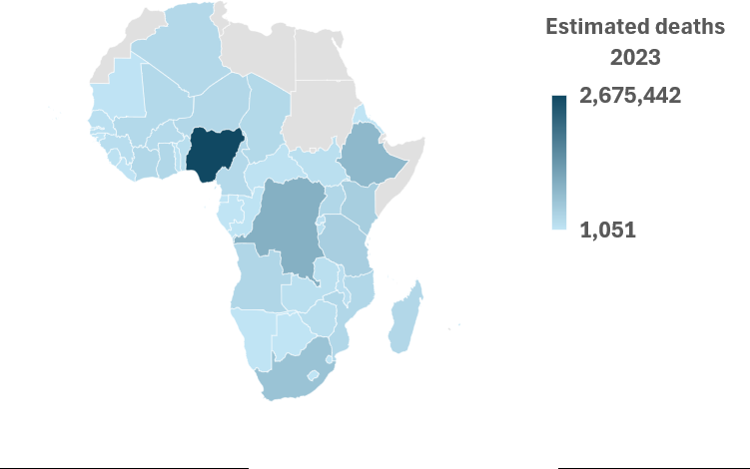
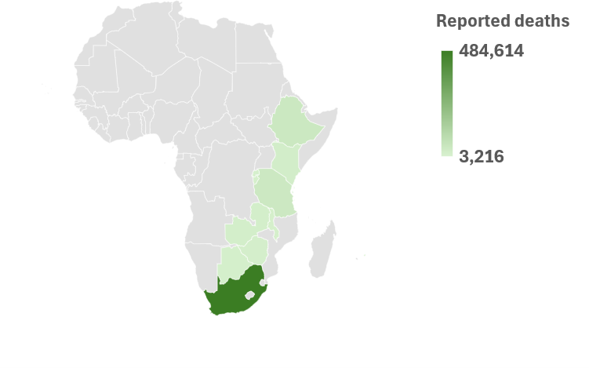
REVIEW OF REGIONAL DATA
Estimated deaths vs reported deaths
13 / 47
0.7M / 10M
countries have submitted data to WHO
deaths are reported of ~10 million estimated
Estimated deaths, 2023
Reported deaths
Source: WPP 2024
Source: WHO 2026
07 / 20

Slide 8
DATA AVAILABILITY
Cause-of-death data for the 2026 report
Country | Est. deaths 2023 | ICD version | Start | Latest | Total deaths
Botswana | 14,197 | ICD-10 (4-digit) | 2021 | 2021 | 17,350
Burundi | 91,963 | ICD-10 (3/4-digit) | 2018 | 2023 | 15,778
Ethiopia | 767,018 | ICD-11 | 2023 | 2023 | 45,451
Ghana | 237,869 | Not analysed (mixed coding)
Kenya | 399,024 | ICD-10 (3-digit) | 2020 | 2022 | 23,652
Malawi | 113,181 | ICD-11 | 2020 | 2024 | 15,904
Mauritius | 11,124 | ICD-10 (4-digit) | 2015 | 2024 | 12,492
Rwanda | 82,826 | ICD-10 (4-digit) | 2021 | 2023 | 14,572
Seychelles | 1,051 | ICD-10 (numeric) | 2015 | 2021 | 925
South Africa | 584,015 | ICD-10 (3-digit) | 2015 | 2020 | 484,614
U. R. Tanzania | 385,799 | ICD-10 (3-digit) | 2020 | 2022 | 42,385
Zambia | 107,917 | ICD-10 (4-digit) | 2017 | 2020 | 20,743
Zimbabwe | 124,412 | ICD-10 (4-digit) | 2019 | 2022 | 17,671
Timeliness
Malawi and Mauritius provided data up to 2024 — excellent turnaround.
Version of ICD
Ethiopia and Malawi submitted data coded to ICD-11 — among early adopters. Ghana was not analysed due to mixed coding.
Source: WHO 2026
08 / 20

Slide 9
EVALUATION CRITERIA
Data evaluated using the ANACoD3 tool
A
Completeness
USABILITY INDEX
Compares the number of reported deaths with the number expected by the UN Population Division.
Usability = Completeness × (1 − % ill-defined)
B
Quality
Evaluates cause-of-death quality from the proportion of ill-defined causes.
Ill-defined causes include the R-chapter and poorly specified causes across all chapters in ICD-10.
Source: ANACoD3
09 / 20

Slide 10
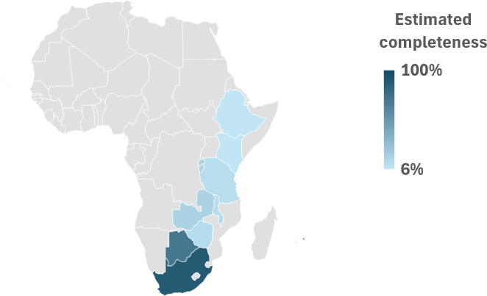
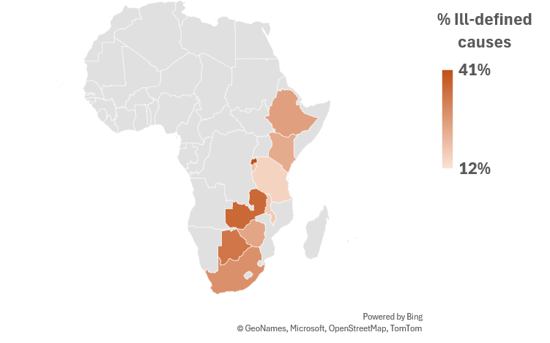
REVIEW OF REGIONAL DATA
Quality of cause-of-death data submitted (n=13)
Completeness
Ill-defined causes
8 countries below 20% completeness
Quality varies widely — 12% to 41% ill-defined
Source: Analysed using ANACOD3
Source: Analysed using ANACOD3
10 / 20

Slide 11
REVIEW OF REGIONAL DATA
Usability of cause-of-death data submitted
Country | Total deaths | Completeness | % Signs & symptoms | % Ill-defined | Usability index
Botswana | 17,350 | 72% | 27% | 33% | 48%
Burundi | 15,778 | 17% | 8% | 18% | 14%
Ethiopia | 45,451 | 6% | 9% | 25% | 5%
Ghana | Not analysed — different coding
Kenya | 23,652 | 6% | 6% | 23% | 5%
Malawi | 15,904 | 12% | 6% | 17% | 10%
Mauritius | 12,492 | 100% | 4% | 12% | 88%
Rwanda | 14,572 | 18% | 18% | 41% | 11%
Seychelles | 5,148 | — | — | — | 98%
South Africa | 484,614 | 89% | 17% | 28% | 64%
U. R. Tanzania | 42,385 | 11% | 6% | 15% | 9%
Zambia | 20,743 | 17% | 28% | 36% | 11%
Zimbabwe | 17,671 | 12% | 5% | 24% | 9%
Usability index
2 countries
> 80%
2 countries
40 – 80%
8 countries
< 20%
1 country
not assessed
Source: Analysed using ANACoD3
11 / 20

Slide 12
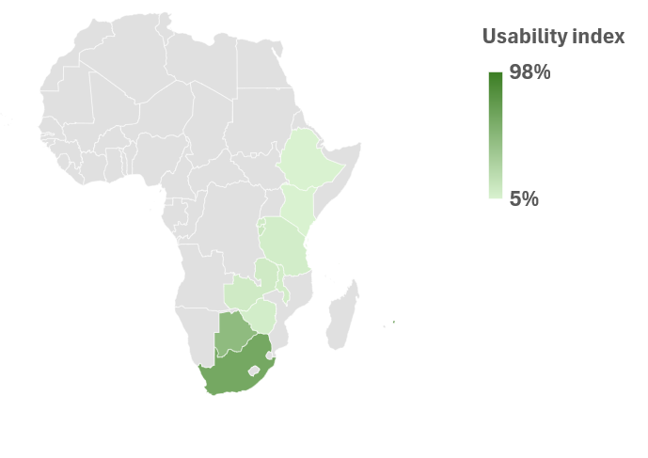
REVIEW OF REGIONAL DATA
Usability of cause-of-death data submitted
2
countries
usability > 80%
2
countries
usability 40 – 80%
8
countries
usability < 20%
1
country
usability not assessed
Source: Analysed using ANACoD3
12 / 20

Slide 13
Are there any signs of improvement?
SCORE ASSESSMENT
SCORE Assessment
A global WHO survey based on countries' self-assessment of their Health Information System, 2019 and 2024.
The “C” in SCORE
Count births and deaths
— and causes of death to know what people die from.
13 / 20

Slide 14
DEATH REGISTRATION (N=46)
More countries are now reporting
Slight improvements observed between 2019 and 2024
2019
2024
Missing
Nascent
Limited
Moderate
Well-developed
Sustainable
Source: WHO SCORE surveys
14 / 20

Slide 15
SCORE — ENABLING INFRASTRUCTURE
Supports for birth & death registration
1
Legal framework for CRVS
2
Sufficient registration locations
Adequate, enforced legislation making birth/death registration compulsory
Population has easy access to places to register births and deaths
3
Interagency collaboration
4
Electronic data exchange
Formally established, oversees planning, engages key stakeholders, meets regularly
Data flows from local → regional → central offices
5
Data quality assurance
6
System performance monitoring
Analysis of vital statistics with regular high-quality VS publications
Regular assessment of the system's overall performance
Source: WHO SCORE survey
15 / 20

Slide 16
CERTIFICATION & REPORTING (N=46)
Certification lags behind registration
2019
2024
Missing
Nascent
Limited
Moderate
Well-developed
Sustainable
Source: WHO SCORE surveys
16 / 20

Slide 17
SCORE — ENABLING INFRASTRUCTURE
Support for certification & reporting
1
Legislation for MCCD
2
ICD-compliant MCCD forms are used
3
Medical students trained in correct death certification
4
Statistical clerks trained in mortality coding
5
Verbal autopsy applied (where applicable)
6
Data quality assurance & dissemination of CoD data
7
Cause-of-death statistics available and published
Source: WHO SCORE survey
17 / 20

Slide 18
REFLECTIONS
Where does the region stand?
Progress
Quality of data
A growing number of countries in the region now have nascent systems for cause-of-death data.
There is enormous scope to improve the quality of the data.
At the same time, we need to consider how the available data can be used as it starts to become available.
13 countries have started submitting data to WHO — up from a much smaller base.
18 / 20

Slide 19
WAY FORWARD
Strengthen systems – and use data as we go
1
Continental framework
2
Start where you are
A shared regional approach to CRVS and mortality surveillance that provides a roadmap for countries to develop and strengthen systems
Expand use of Verbal Autopsy to capture community and out-of-facility deaths
Strengthen medical certification and reporting of deaths in health facilities
Move to a fully integrated mortality surveillance within the CRVS system
3
4
5
WHO standard and tools
M&E
Use data as we go
Implement WHO standards and digital tools to support implementation, data management, and reporting
Track progress against clear, staged improvement milestones
Continuous data use and quality improvement - put available data to work now, rather than waiting for perfection
19 / 20

Slide 20
ACKNOWLEDGEMENTS
Thank you
WHO Headquarters
Doris Ma Fat · Anh Hong Chu · Hussein Hassani
WHO AFRO Office
Regional office team
SA WHO-FIC Collaborating Centre
Lyn Hanmer · Megan Prinsloo · Natasha Kallis · Eunice Turawa
Notes:
Acknowledgements and thanks.

